Slide 1
Pattern for CEL and CEA

Slide 2
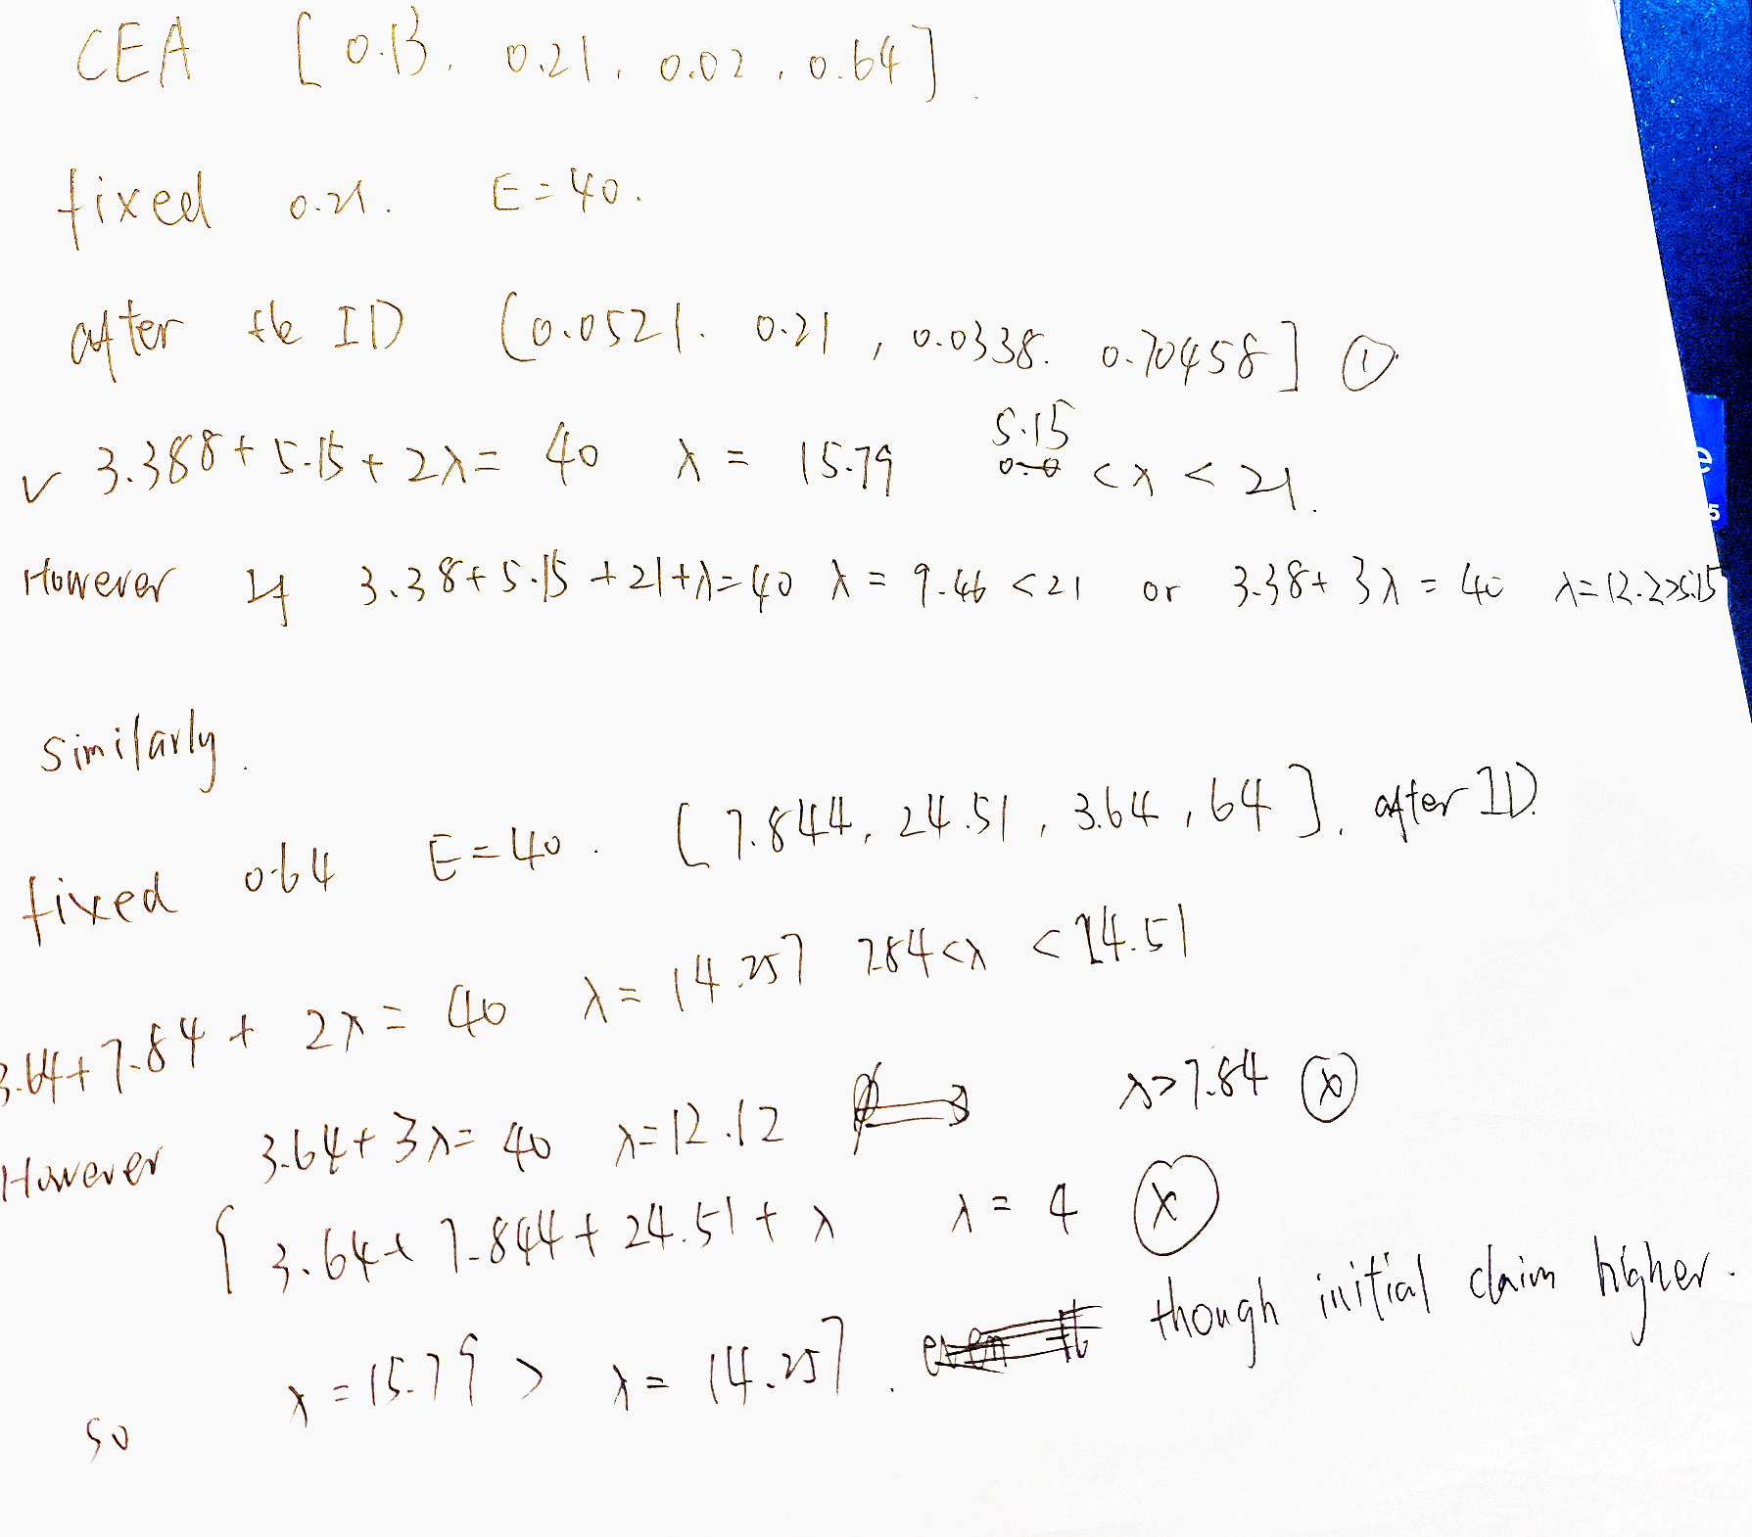

Is something wrong?

Slide 3

Pattern for CEA is clear
For restricted case, similarly to unbounded, only two 0.01 and put all weight to other
Unbounded always in style: X is fix, 0.01,0.01, 1-0.02-X

Slide 4
Pattern for CEL in restricted case
Besides for one fixed column X
One column should start from 0.01 to certain cutoff Y
One possible pattern: The remaining two column start with X, 0.01, 0.01, 1-0.02-X to X, Y, 0.01, 1-0.01-X-Y. The third and fourth column can interchange.
Since the only how many agents active determines whether we can improve the final output, so unbounded and restricted will have the same optimal output

Slide 5
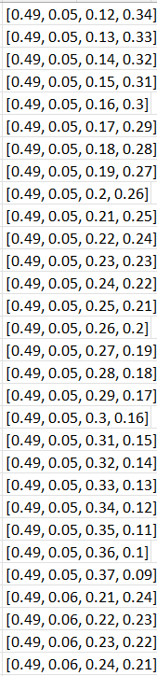
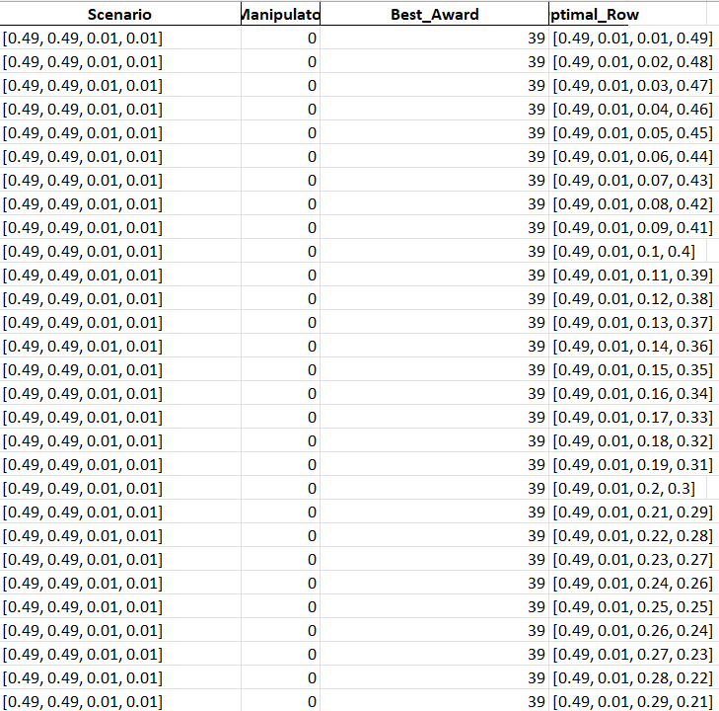
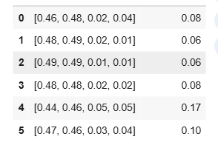
0.49,0.49,0.01,0.01 (E=60

Slide 6
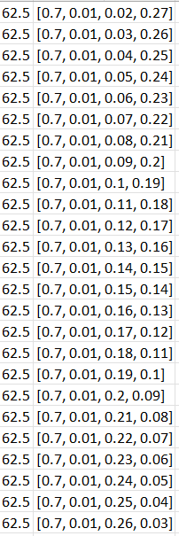
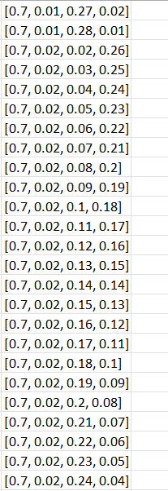
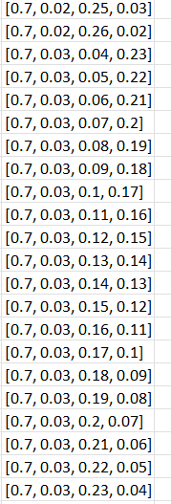
[0.7, 0.2, 0.05, 0.05] (E=70)

Slide 7
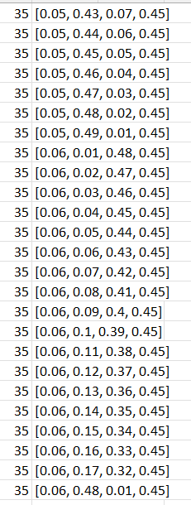
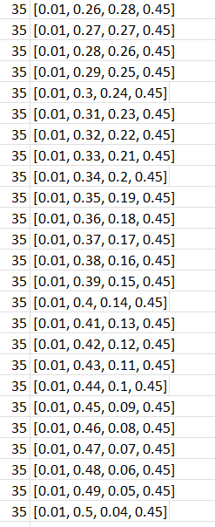
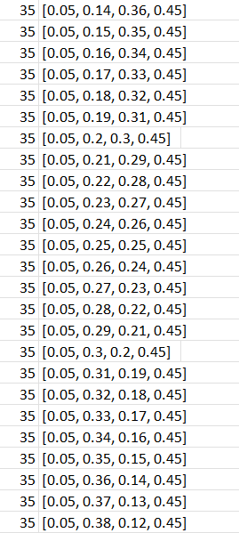
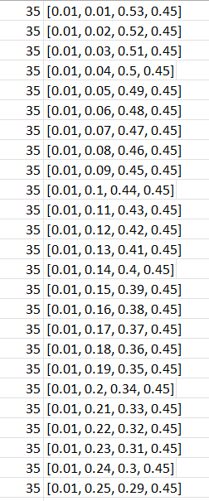
[0.5, 0.01, 0.04, 0.45] E=60

Slide 8
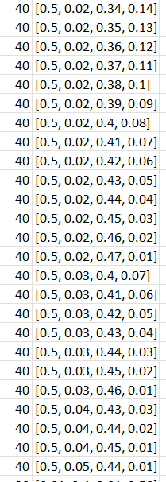
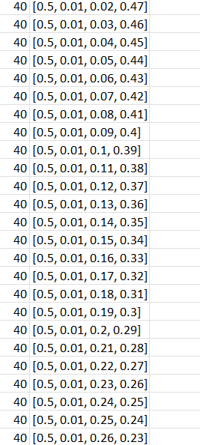
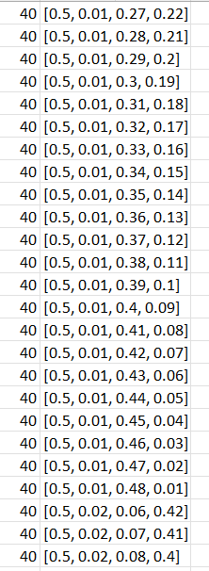
[0.5, 0.4, 0.02, 0.08]

